Slide 1
3D Smooth Blending for subdivision surfaces
Prepared by: Yousef Hesham Samir
Supervisor: Dr. Ahmed Farouk

Slide 2
1.
Introduction

Slide 3
Chapter 1: Introduction
Motivation
For decades, 3D modeling and blending has been a tremendously crucial branch of the 3D object creation and manipulation. Nearly in every game, application or movie we see some sort of blending technique to give a certain effect or action. Blending freeform objects modeled with subdivision surfaces can be used in a variety of applications.
Objective
The objective of this project is to develop a software than can load and view 3D meshes, then apply subdivision technique to obtain a finer/smoother mesh using Catmull-Clark subdivision scheme. As well as being able to blend these freeform object meshes together while maintaining the overall smoothness of the object.

Slide 4
2.
Background and Related Work

Slide 5
What is subdivision?
Subdivision is simply defining a finer/smoother mesh of control-points resulting from a process that uses a base mesh and repeatedly refining it in multiple levels and constantly adding new vertices, faces and edges.
There are multiple subdivision techniques out there that give slightly different results but they all serve the same purpose of subdivision.

Slide 6
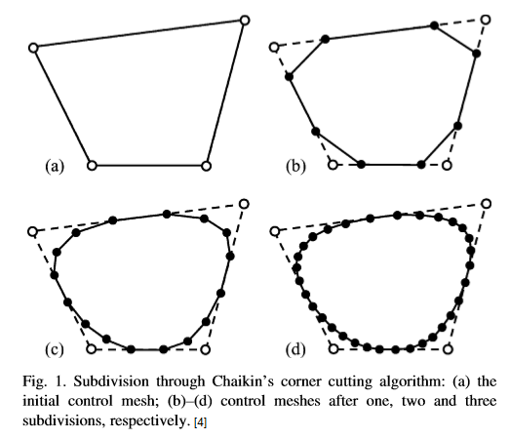
Chaikins subdivision algorithm
In Fig. 1, we can see a 4 edge curve (closed) that has been refined 3 times using the corner cutting method, which is a technique used in Chaikins subdivision algorithm. Each control vertex of the curve in the iterative mesh is calculated as a percentage mixture of previous bordering vertices. To that end, the new mesh changes to a smoother curve, which is widely known as uniform quadratic B Spline curve.
Fig. 1

Slide 7
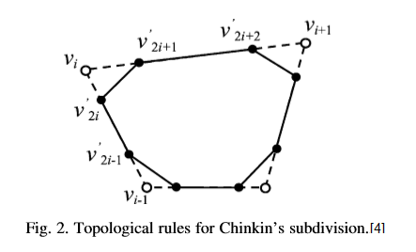
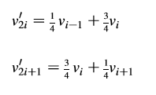
Chaikins subdivision algorithm
The topological rules are shown in Fig. 2, which is widely called as corner cut technique. For each control/previous vertex Vi, we cut off the corner curve by adding two vertices, which create a new edge that connects the two recently added vertices. The overall lengths of all previous edges will be reduced.
Fig. 2

Slide 8
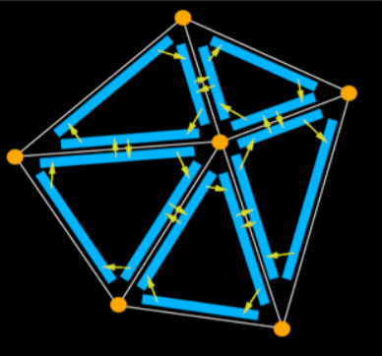
Half-edge data structure
A half-edge data structure contains a record for each edge, vertex and face of the subdivision. Each edge usually bounds two faces, therefore, it is convenient to regard each edge as two "half-edges". Each half-edge is "associated" with a single face and thus has a pointer to that face. All half-edges associated with a face are clockwise or counter-clockwise. A half-edge has a pointer to the next half-edge and previous half-edge of the same face as shown in Fig. 3.
Fig. 3

Slide 9
3.
Project planning and monitoring

Slide 10
Functional Requirements
The program will display a given 3D Model in free space, giving the user the ability to manipulate it in 3D Space.
The user should be able to load/display any number of objects.
The user can then select an object, and perform one or more subdivision iterations on this object, making it smoother, smaller and increasing the number of vertex points in that object.
The user can move these objects in free space.
The user can blend 2 objects into 1 smoothed object.

Slide 11
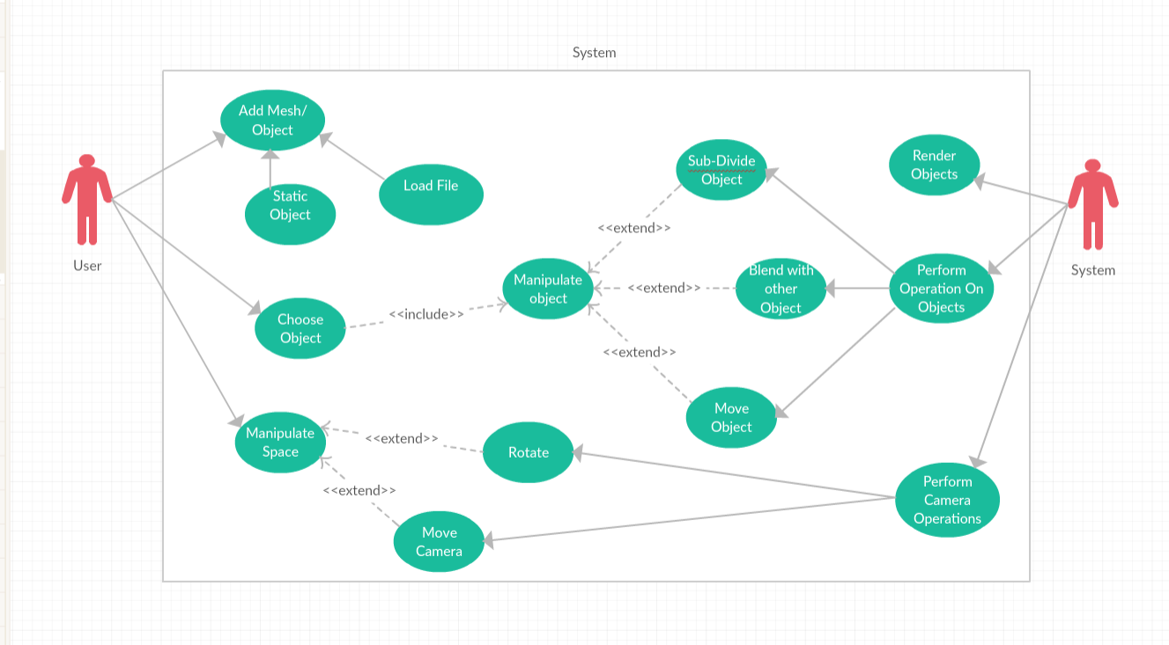
Use Case Diagram

Slide 12
4.
Implementation

Slide 13
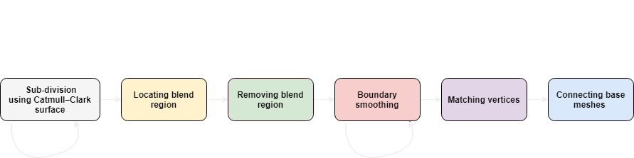
Block Diagram
The six stages of the propsed smooth blending technique for subdivision surfaces.

Slide 14
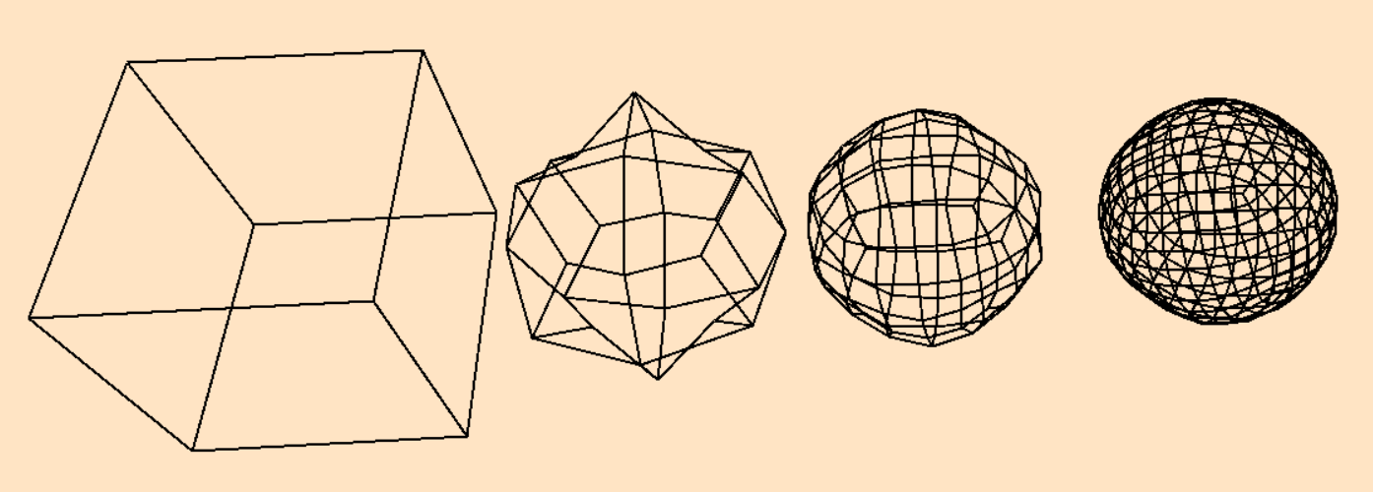
Sub-division using Catmull–Clark surface
There are three basic steps to subdividing a mesh of control-points.
Stage Input: A mesh of control points
Stage Output: A finer mesh of control-points that contains more polygon faces. This mesh can then be passed again through the same process.
Fig. 4

Slide 15
There are three basic steps to subdividing a mesh of control-points.
Inserting face, edge points.
reallocation of the vertex-points.
Connecting the inserted points.

Slide 16
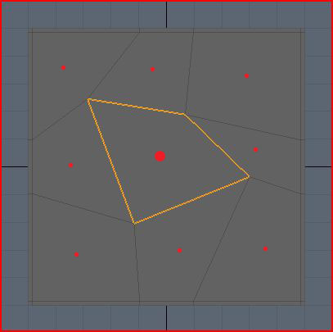
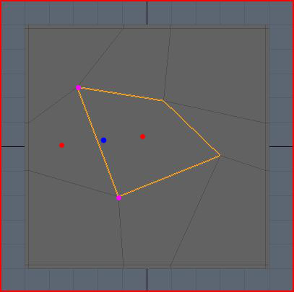
Sub-division: Step One
Fig. 5
Fig. 6
The red dots are simply where the face points will approximately be. Each face point is the sum of all the controlling points of a face divided by the number of the controlling points.
Similarly for edge points they are also the average of the two points creating the edge and the two face-points of the neighboring faces, which makes it affected by four points in total.

Slide 17
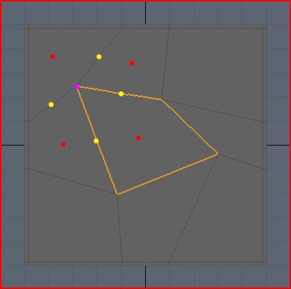
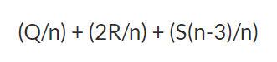
Sub-division: Step Two
Fig. 7
In this step, The new location of the vertex-points is set, weighted average must be used to determine the new location of the vertex-point. Weighted average is basically a normal average except that some of the values will have greater effect on the final result that other values.
The new location of the vertex point will be according to the equation, Where Q is the average of the neighboring face points, R is the average of the surrounding edge midpoints, S is the original control point, and n is the point valence.

Slide 18
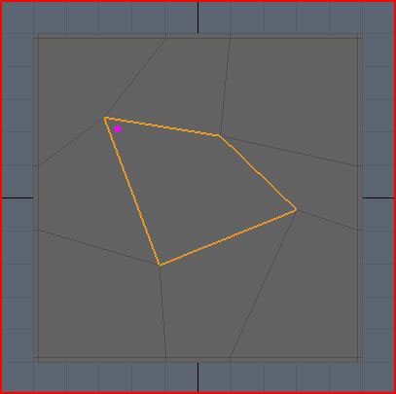
Sub-division: Step Two
Fig. 8
In Fig. 8, the pink dot is approximately where the new vertex point will be. The control point is pulled down to the right, because all the surrounding points were averaged and weighted according to the equation to pull the vertex around, which also mean that if a vertex is next to large face and three small ones, the large face is going to pull the vertex to it more than the small ones do.

Slide 19
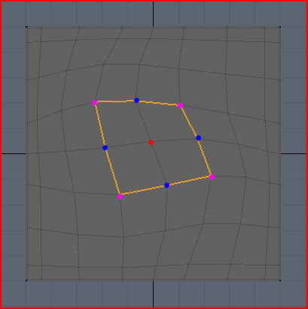
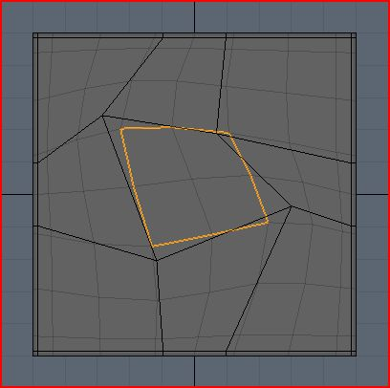
Sub-division: Step Three
In this step, all the newly inserted face points and edge points along with the reallocated vertex points are to be connected together to form four new faces
Fig. 9
Fig. 10

Slide 20
Block Diagram
The six stages of the propsed smooth blending technique for subdivision surfaces.

Slide 21
Locating the blend region
In this stage, the blend region where the two subdivided meshes may intersect must be located. This is to locate the intersecting faces between the two base meshes.
Stage Input: two intersected objects.
Stage Output: Locating the intersected polygons of the two objects.

Slide 22
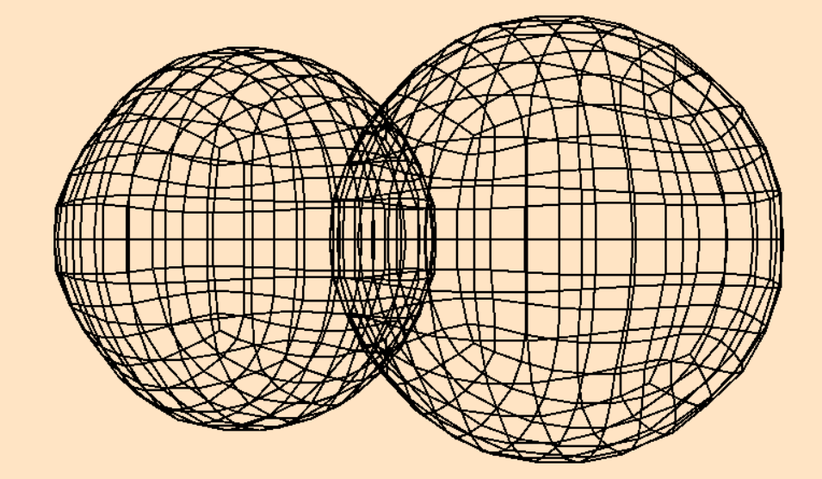
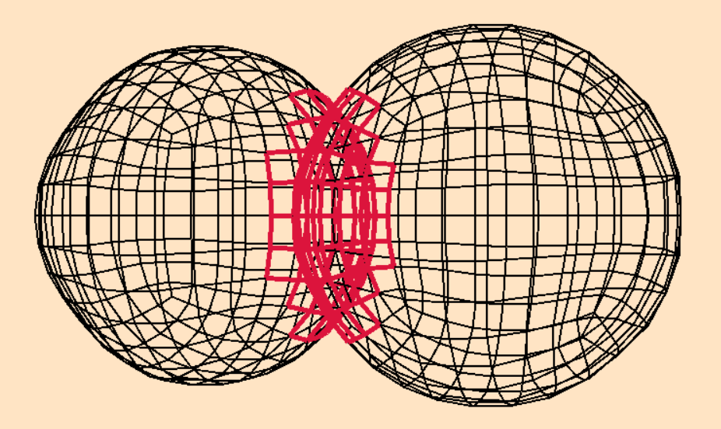
Locating the blend region
Fig. 11
Fig. 12

Slide 23
Locating the blend region
Since an exact intersection of the two subdivision surfaces Sp, Sq is not required, a simple collision detection method was adopted to locate the blend region. A sphere-tree is build for each of Sp and Sq. A sphere encloses a certain polygon of the surface, denote h_{pi} as a sphere of Sp enclosing a polygon p_{i}. Similarly, h_{qj}, denotes a sphere of Sq enclosing a polygon p_{j} . If h_{pi} ∩ h_{qj} ≠ φ, then p_{i} and p_{j} may possibly intersect. The two polygons can then be discarded. Since a precise intersection is not required, the blend region can be located for some objects that do not intersect but are close enough.

Slide 24
Block Diagram
The six stages of the propsed smooth blending technique for subdivision surfaces.

Slide 25
Removing the blend region
In this stage, and after the intersected polygons between the two meshes have been determined, the blend region will be discarded.
Stage Input: List of intersected polygons between two meshes.
Stage Output: Discarding these polygons, determining a list of boundary points and edges.

Slide 26
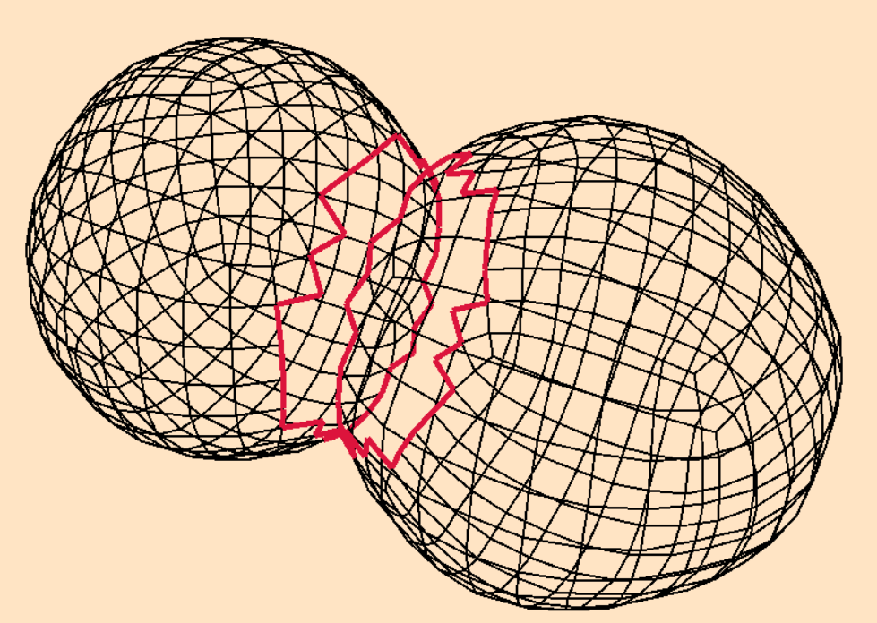
Removing the blend region
Fig. 13
Fig. 14

Slide 27
Removing the blend region
Discarding the list of intersected polygons requires multiple updates in the data structures of each of the two intersected meshes
As a result, after discarding all undesired polygons of the blend region, a boundary curve appears on both objects where the blend region used to be as seen in Fig. 12. Boundary points and Boundary edges lying on the boundary curve must be located in preparation for the boundary smoothing stage.

Slide 28
Block Diagram
The six stages of the propsed smooth blending technique for subdivision surfaces.

Slide 29
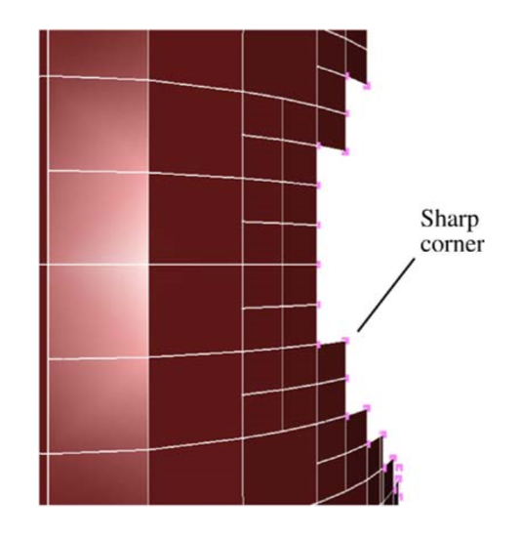
Boundary smoothing
After discarding the blend region polygons, the resulting boundary curves may have sharp vertices as shown in Fig. 15, these sharp corners will eventually become sharp corners on the boundary of the blend area, which leads to a surface with ripples. In this stage, sharp corners are to be smoothed out, and this process can be done in iterations.
Stage Input: List of Boundary points and Boundary edges.
Stage Output: Smoothed out Boundaries along both meshes.
Fig. 15

Slide 30
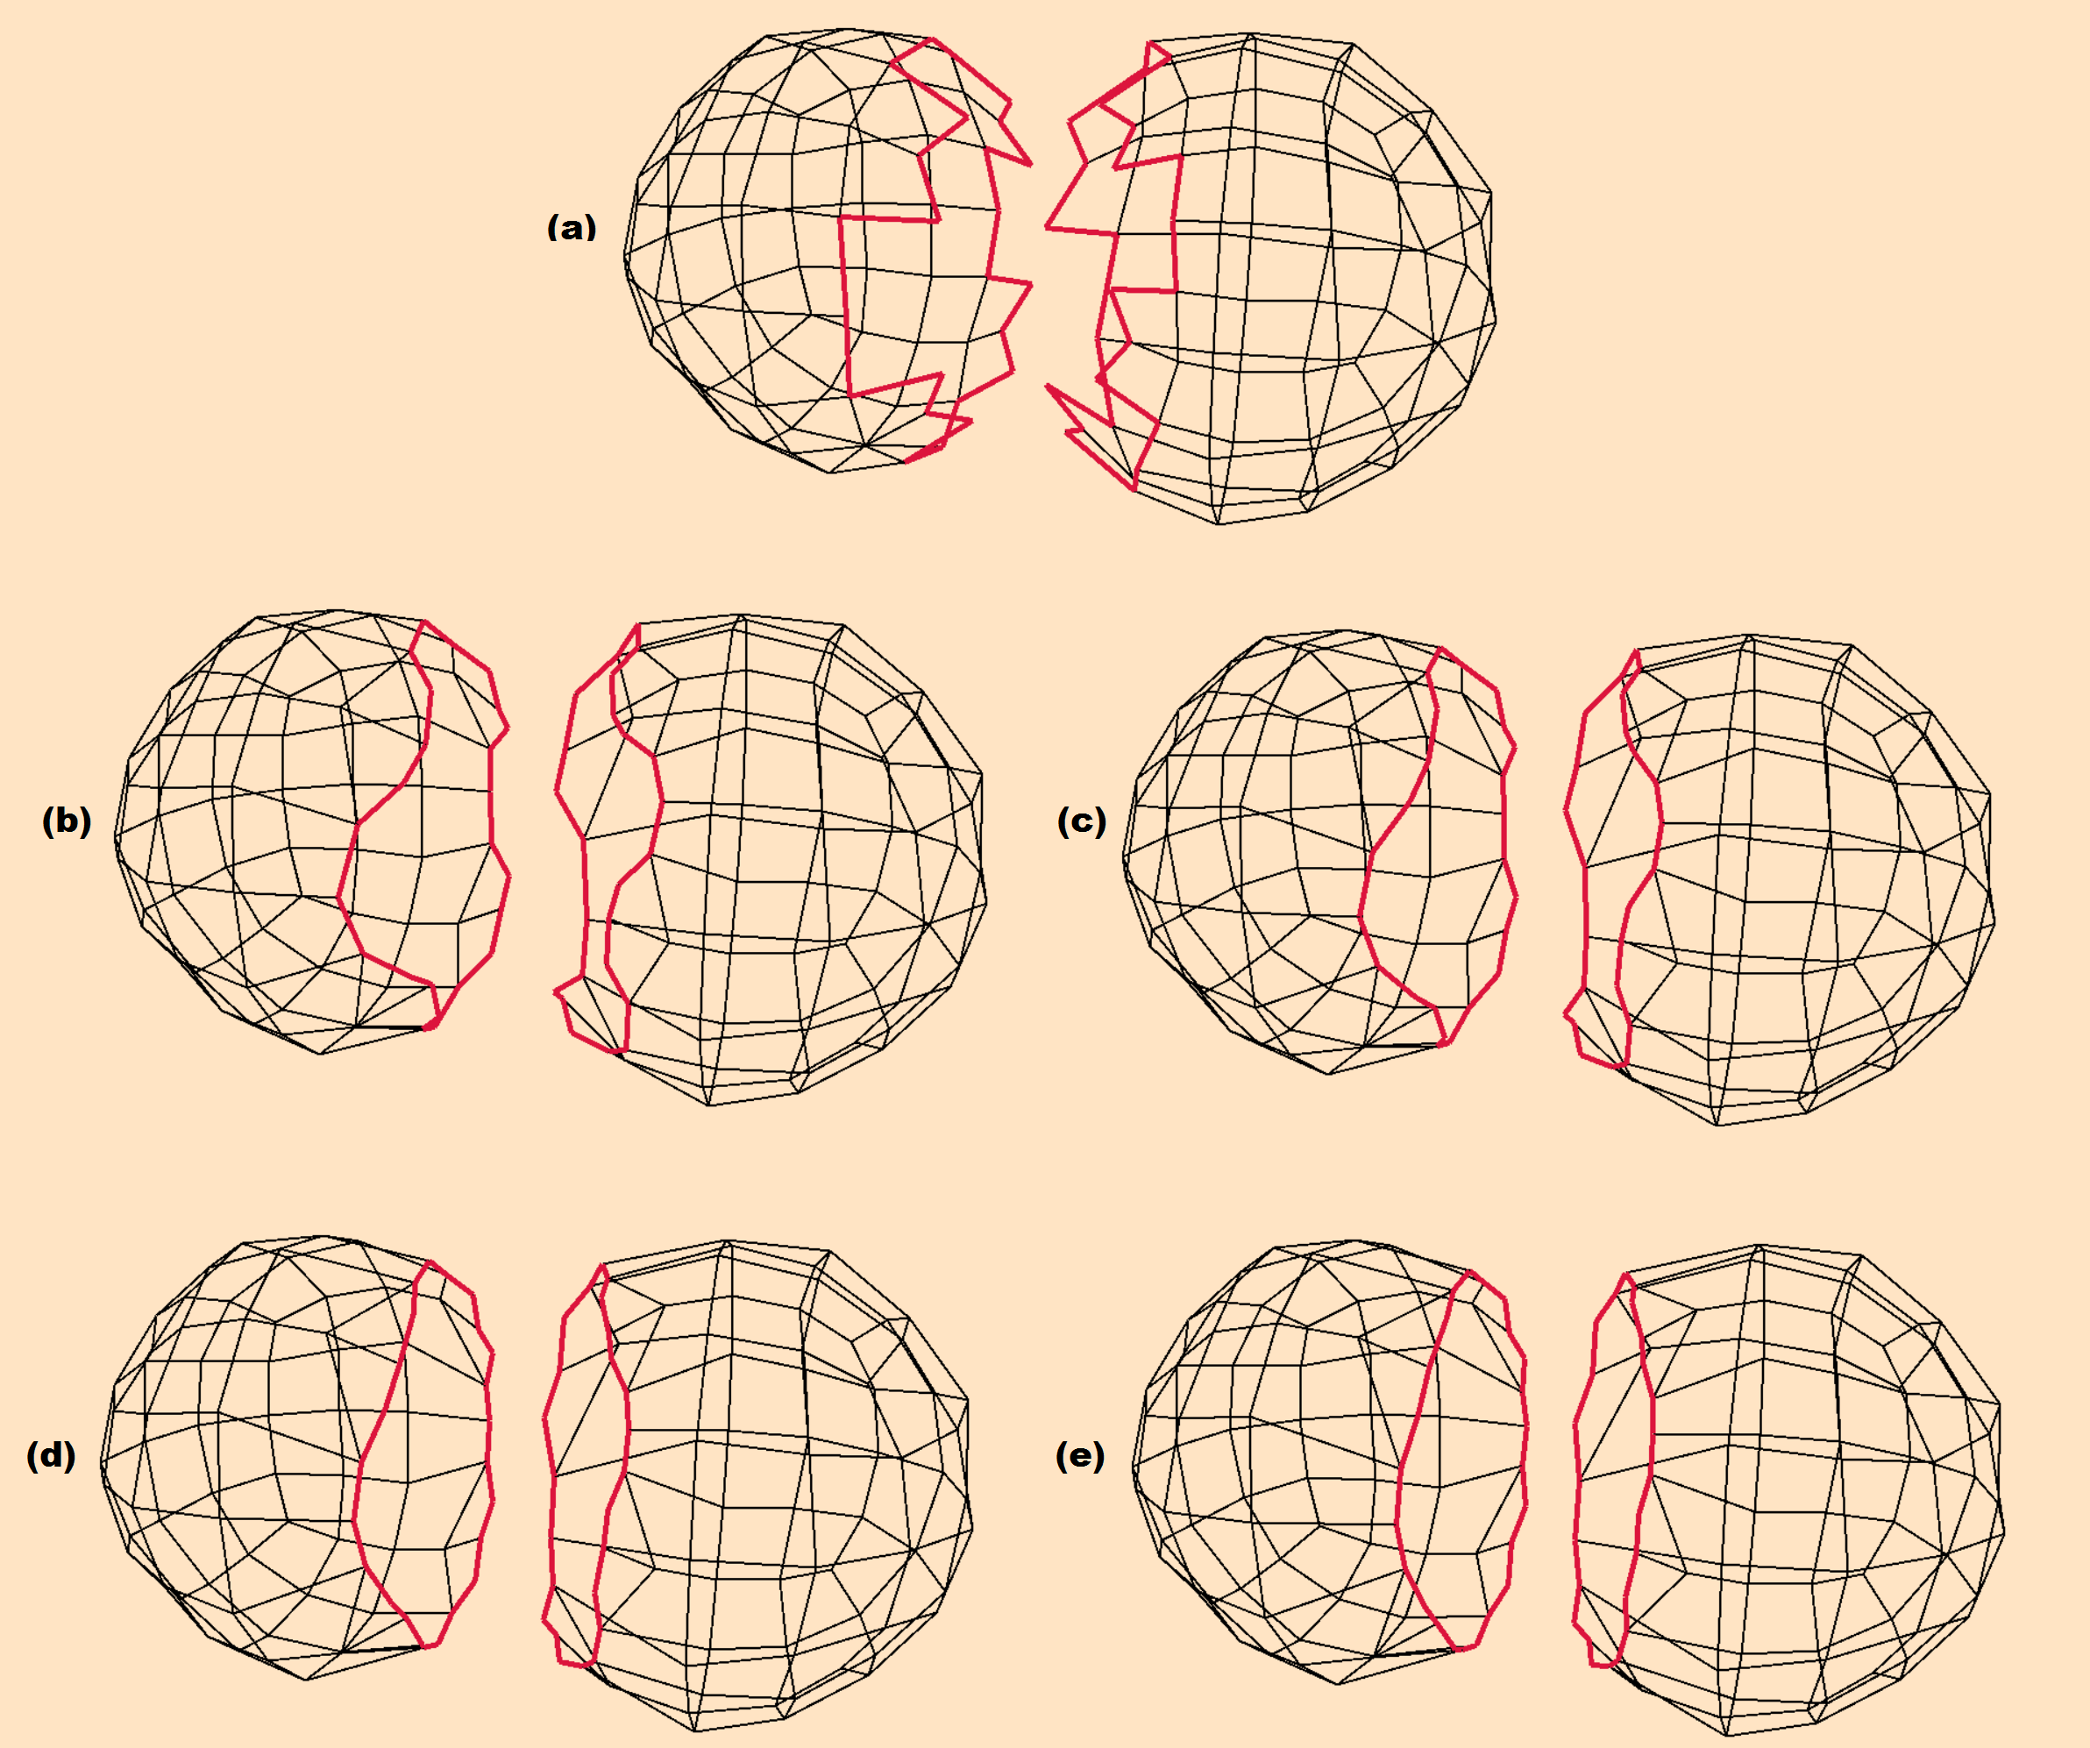
Boundary Smoothing

Slide 31
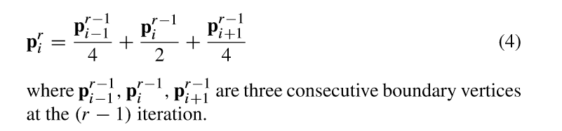
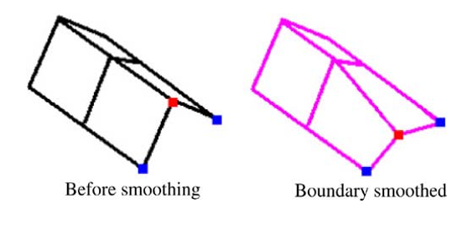
Boundary Smoothing
A boundary smoothing process is expressed as:
Fig. 16
The iteration in the previous Eq. may in some cases cause a distorted boundary as shown in Fig. 16. The solution to this is adding an additional constraint to make sure that the vertices will only be modified on the tangent plane of the surface.

Slide 32
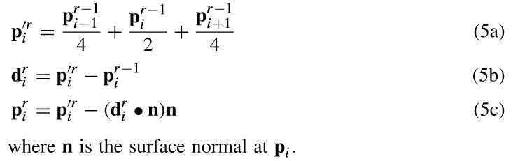
Boundary Smoothing
The equation is then written as follows
This equation can be performed multiple times to further smooth the boundaries.

Slide 33
Block Diagram
The six stages of the propsed smooth blending technique for subdivision surfaces.

Slide 34
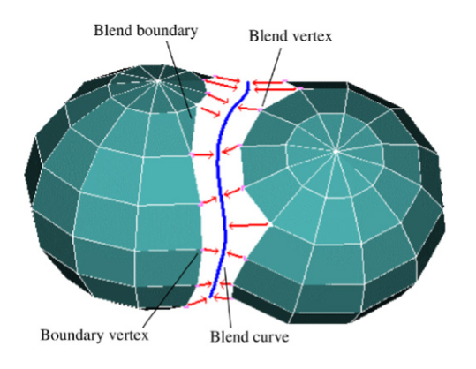
Matching vertices
Fig. 17
In this stage, the controlling points of the meshes along the boundary curves are to be paired together in preparation for connecting them to a new constructed blend curve lying inside the blend region as shown in Fig. 17.
Stage Input: List of Boundary points and Boundary edges (After smoothing).
Stage Output: Vertex pairs.

Slide 35
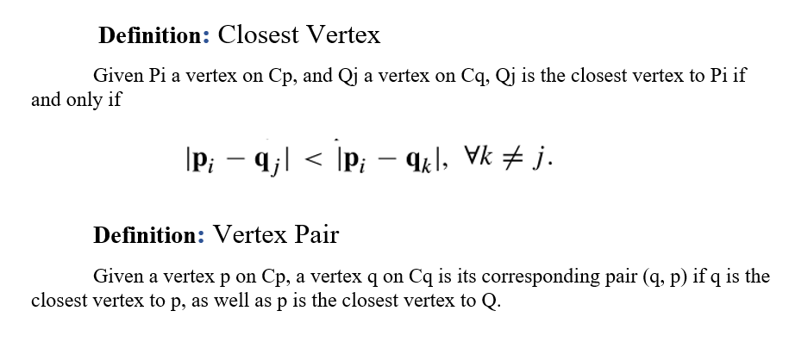
Matching vertices
The pairing process between vertices is established by matching the two curves Cp and Cq according to the following definitions:

Slide 36
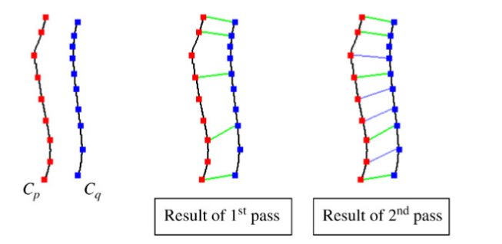
Matching vertices
Fig. 18
Since there might be a difference in the mesh densities of the two surfaces resulting from using two different subdivision levels, the pairing process must be applied iteratively to match vertices on Cp and Cq. Fig. 18 shows the process with two iterations. This process must be repeated until no more pairs can be created.

Slide 37
Block Diagram
The six stages of the propsed smooth blending technique for subdivision surfaces.

Slide 38
Connecting base meshes
After successfully pairing the boundary points of both meshes, a blend curve must be established for connecting the base meshes together and generating the blended mesh. The blend curve will be located to keep the extraordinary vertices lying on a flat region of the surface and reduce distortion if possible.
Stage Input: Two lists of the paired vertices.
Stage Output: Complete blending of the two intersected meshes.

Slide 39
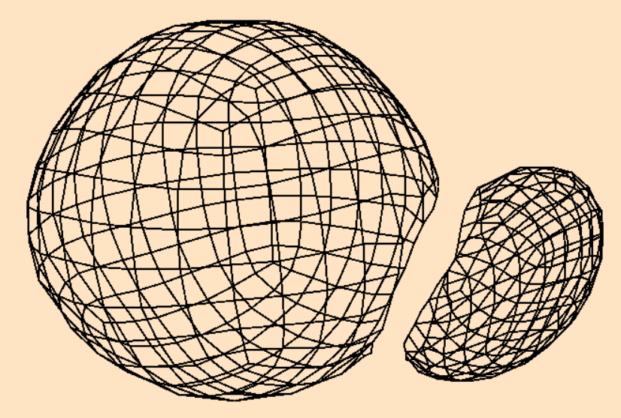
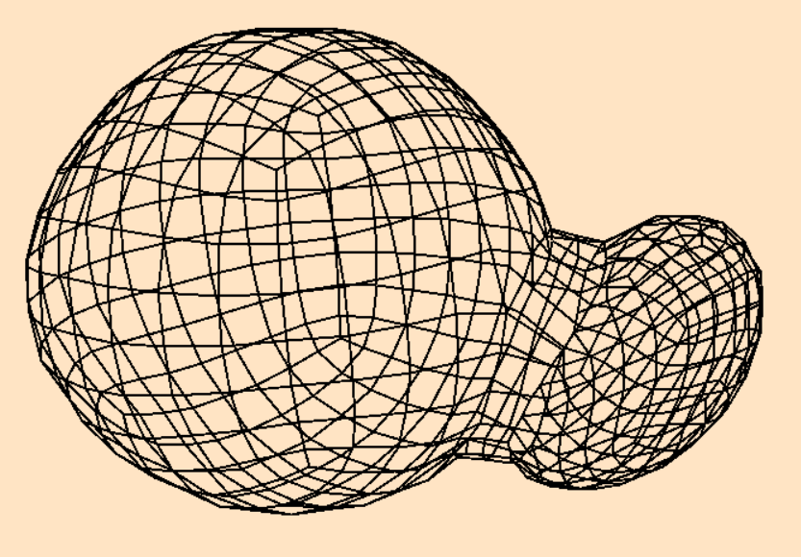
Connecting base meshes
Fig. 19
Fig. 20

Slide 40
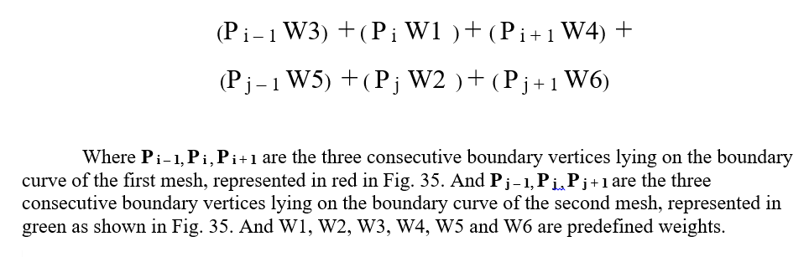
Connecting base meshes
For each pair of vertices, a new point will be created and added to the blend curve, the new point locations determined according to the following equation:

Slide 41

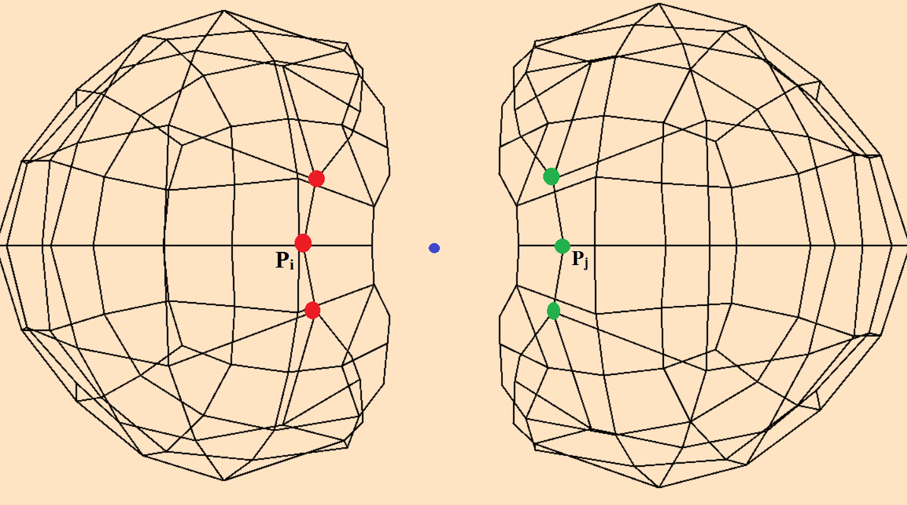

Slide 42
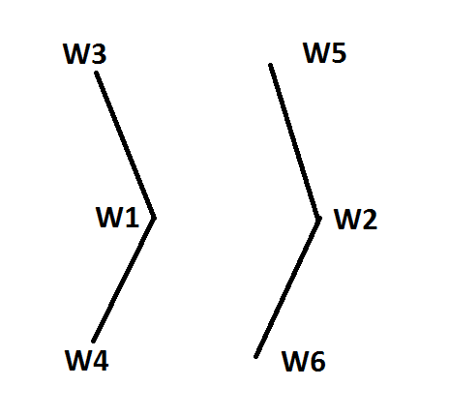
Connecting base meshes
As for the weights, collections of different weights have been applied to the equation, each group of weights gives different results, because each group influences the value of the final point based on the six points we account for. These weights must sum up to a total of 1.
Fig. 21

Slide 43
Connecting base meshes
 | W1 | W2 | W3 | W4 | W5 | W6
Weights (A) | 0.5 | 0.5 | 0 | 0 | 0 | 0
Weights (B) | 0.3 | 0.3 | 0.1 | 0.1 | 0.1 | 0.1
Weights (C) | 0.4 | 0.4 | 0.05 | 0.05 | 0.05 | 0.05
Weights (D) | 0.1666 | 0.1666 | 0.1666 | 0.1666 | 0.1666 | 0.1666
Weights (E) | 0.2 | 0.2 | 0.15 | 0.15 | 0.15 | 0.15
Weights (F) | 0.1 | 0.1 | 0.2 | 0.2 | 0.2 | 0.2

Slide 44
Connecting base meshes
After creating the blend curve successfully, the connection between the first mesh and the blend curve must be established, as well as connecting the second mesh with the blend curve. Keeping in mind that this topology generates a valance of four in all the blend curve area. Several updates must be made for the new blended object.
Adding both meshes vertices, polygons and edges.
Adding the newly inserted points of the blend curve.
Adding the edges that connect both meshes with the blend curve.
Creating polygons from the blend curve area and adding them to the object.

Slide 45
5.
Testing and Evaluation

Slide 47
Weights
 | W1 | W2 | W3 | W4 | W5 | W6
Weights (A) | 0.5 | 0.5 | 0 | 0 | 0 | 0
Weights (B) | 0.3 | 0.3 | 0.1 | 0.1 | 0.1 | 0.1
Weights (C) | 0.4 | 0.4 | 0.05 | 0.05 | 0.05 | 0.05
Weights (D) | 0.1666 | 0.1666 | 0.1666 | 0.1666 | 0.1666 | 0.1666
Weights (E) | 0.2 | 0.2 | 0.15 | 0.15 | 0.15 | 0.15
Weights (F) | 0.1 | 0.1 | 0.2 | 0.2 | 0.2 | 0.2

Slide 51
6.
Conclusion

Slide 52
Connecting base meshes
To conclude, the smooth blending for subdivision surfaces as a method is a great tool for modeling complex freeform meshes while maintaining the smooth effect in the blending process. Other blending techniques use intersecting curves having sharp and extraordinary vertices, which in return generate irregular shapes in the region and cause unwanted distortion. The proposed algorithm on the other hand is very reliable, applicable and smooth. Working on this project has benefited me greatly in understanding different types of complex data structures, as well as the ability to understand and implement complex mathematical equations in a 3D environment.

Slide 53
Thanks!
👍
Any questions?

